Slide 1
VLSI Test Principles and Architectures
Chapter 5, Logic BIST
Haochen Ding

Slide 2
INTRODUCTION
00

Slide 3
00 Introduction
Logic BIST
Definition: a design for testability (DFT) technique in which a portion of a circuit on a chip, board, or system is used to test the digital logic circuit itself.
Category:
Online BIST
Concurrent BIST: conducted simultaneously during normal functional operation. When an intermittent or transient error is detected, the system will correct the error on the spot, rollback to its previously stored system states, and repeat the operation, or generate an interrupt signal for repeated failures.
Nonconcurrent BIST: performed when the functional circuitry is in idle mode.
Offline BIST
Functional BIST: based on the functional specification of the functional circuitry, often employing a functional or high-level fault model
Structural BIST: based on the structure of the functional circuitry
External BIST (using separated circuitry for testing) / Internal BIST (converting functional storage elements into TPG or ORA)

Slide 4
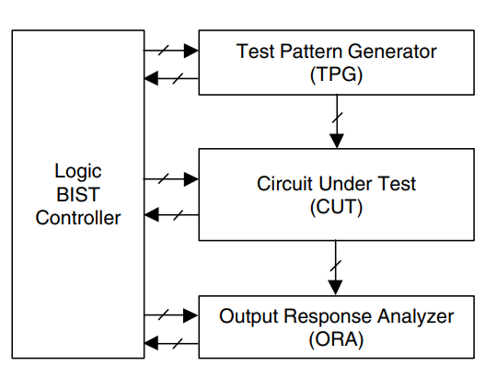
00 介绍
Main architecture of Logic BIST：
The test pattern generator (TPG) automatically generates test patterns for application to the inputs of the circuit under test (CUT).
The output response analyser (ORA) automatically compacts the output responses of the CUT into a signature.
Specific BIST timing control signals, including scan enable signals and clocks, are generated by the logic BIST controller for coordinating the BIST operation among the TPG, CUT, and ORA.
The logic BIST controller provides a pass/fail indication once the BIST operation is complete.

Slide 5
00 Introduction – Contents of This Chapter
01 BIST Design Rules
02 Test Pattern Generation
03 Output Response Analysis
04 Logic BIST Architecture
05 Fault Coverage Enhancement
06 BIST Timing Control

Slide 6
BIST DESIGN RULES
01

Slide 7
01 BIST Design Rules – Unknown Source Blocking
BIST Design Rules: Unknown Source Blocking
Any unknown (X) value that propagates directly or indirectly to the output response analyser (ORA) will corrupt the signature and cause the BIST design to malfunction, making it a must to block and fix it using a DFT repair approach often called X-bounding or X-blocking.

Slide 8
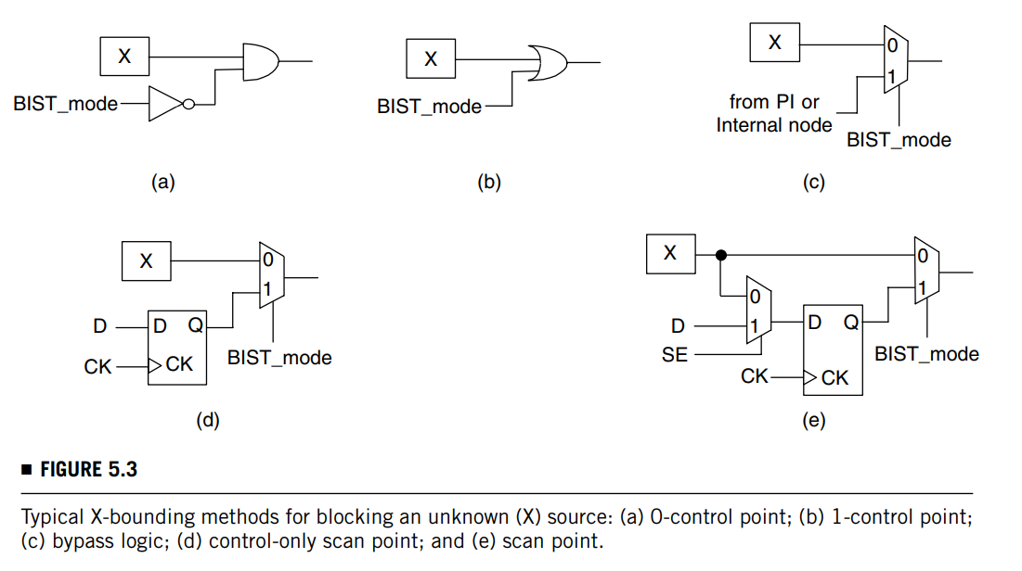
01 BIST Design Rules – Unknown Source Blocking
BIST Design Rules: Unknown Source Blocking
Analogue Blocks
Any analogue block output that can exhibit unknown (X) behaviour during test has to be forced to a known value. The following approaches can be useful:
Adding a 0/1-control point
Adding bypass logic
Adding control-only scan points
The latter two approaches are recommended because they yield higher fault coverage.

Slide 9
01 BIST Design Rules – Unknown Source Blocking
BIST Design Rules: Unknown Source Blocking
Memories and Non-Scan Storage Elements
Bypass logic is typically used to block each unknown (X) value originating from a memory or non-scan storage element.
Using an initialization sequence to set a memory or non-scan storage element to a known state, in order to avoid adding delay to critical (functional) paths.

Slide 10
01 BIST Design Rules – Unknown Source Blocking
BIST Design Rules: Unknown Source Blocking
Combinational Feedback Loops
Avoid
Use a 0-control point, a 1-control point, or a scan point to break the loops

Slide 11
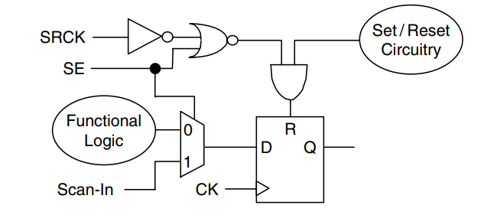
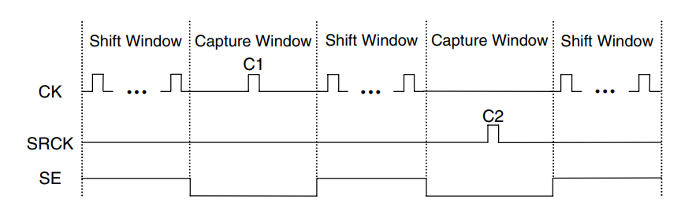
01 BIST Design Rules – Unknown Source Blocking
BIST Design Rules: Unknown Source Blocking
Asynchronous Set/Reset Signals
They can destroy the data during shift operation if a pattern causes them to become active.
The asynchronous set or reset can be disabled using an external set/reset disable (RE) pin.
The methods of using the existing scan enable (SE) signal to protect each shift operation and adding a set/reset clock point (SRCK) on each set/reset signal to test the set/reset circuitry are both recommended. (bottom-left pic)
In addition, testing all data and set/reset faults using two separate BIST sessions is also recommended. (bottom-right pic)

Slide 12
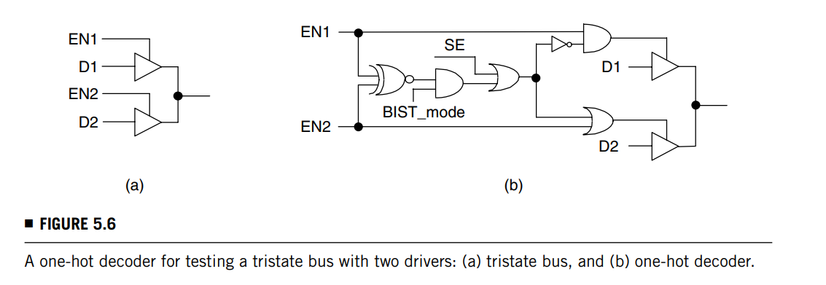
01 BIST Design Rules – Unknown Source Blocking
BIST Design Rules: Unknown Source Blocking
Tristate Buses
To avoid potential bus contention, it is best to resynthesize each bus with multiplexers.
If this is impractical, make sure only one tristate driver is enabled at any given time.

Slide 13
01 BIST Design Rules – Unknown Source Blocking
BIST Design Rules: Unknown Source Blocking
Paths
False Paths: they typically do not meet timing specifications, which can result in a mismatch during logic BIST delay fault testing.
To avoid this potential problem, it is recommended to add a 0-control point or 1-control point to each false path.
Multiple-cycle paths (normal functional paths but data are expected to arrive after two or more cycles): they can cause mismatches if exercised during delay fault testing, as they are intended to be tested in one cycle.
To avoid this potential problem, it is recommended to add a 0-control point or 1-control point to each multiple-cycle path or to hold certain scan cell output states to avoid those multiple-cycle paths.

Slide 14
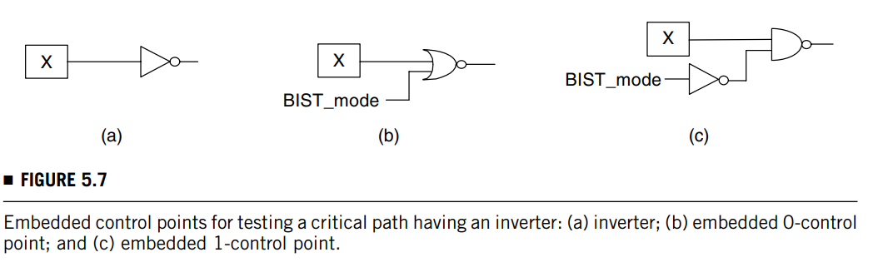
01 BIST Design Rules – Unknown Source Blocking
BIST Design Rules: Unknown Source Blocking
Paths
Critical Paths: no additional gates are in fact allowed to be added to the path due to timing reasons
To remove an unknown (X) value from a critical path, it is recommended to add an extra input pin to a selected combinational gate, such as an inverter, NAND gate, or NOR gate, on the critical path to minimize the added delay.

Slide 15
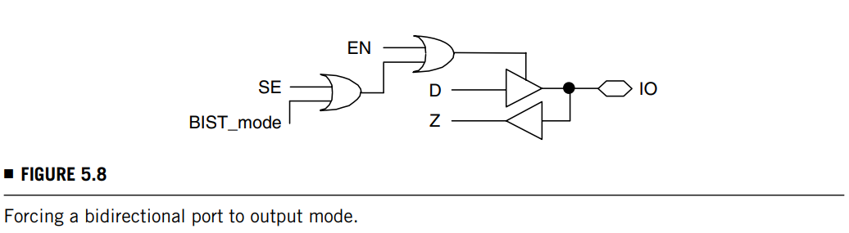
01 BIST Design Rules – Unknown Source Blocking
BIST Design Rules: Unknown Source Blocking
Ports
Neither primary inputs (PIs) nor primary outputs (POs) can be floating. These ports must have a proper connection to power (VDD) or ground (VSS).
Also, floating inputs to any internal modules must be avoided.
Bidirectional I/O ports are commonly used in a design. For BIST operations, make sure to fix the direction of each bidirectional I/O port to either input or output mode.

Slide 16
01 BIST Design Rules – Re-timing
Re-timing
Because the TPG and the ORA are typically placed far from the CUT, races and hazards caused by clock skews may occur between the TPG and the (scan chain) inputs of the CUT as well as between the (scan chain) outputs of the CUT and the ORA.
To avoid these potential problems and ease physical implementation, it is recommended to add a re-timing logic between the TPG and the CUT and between the CUT and the ORA.

Slide 17
TEST PATTERN GENERATION
02

Slide 18
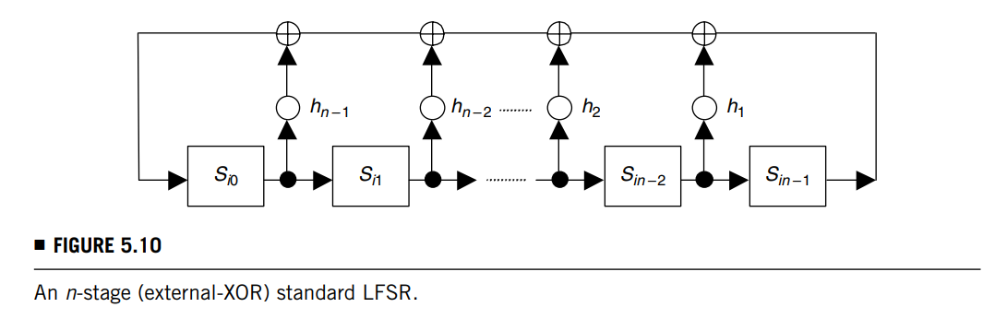
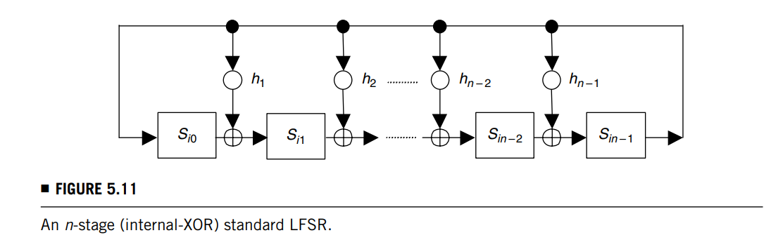
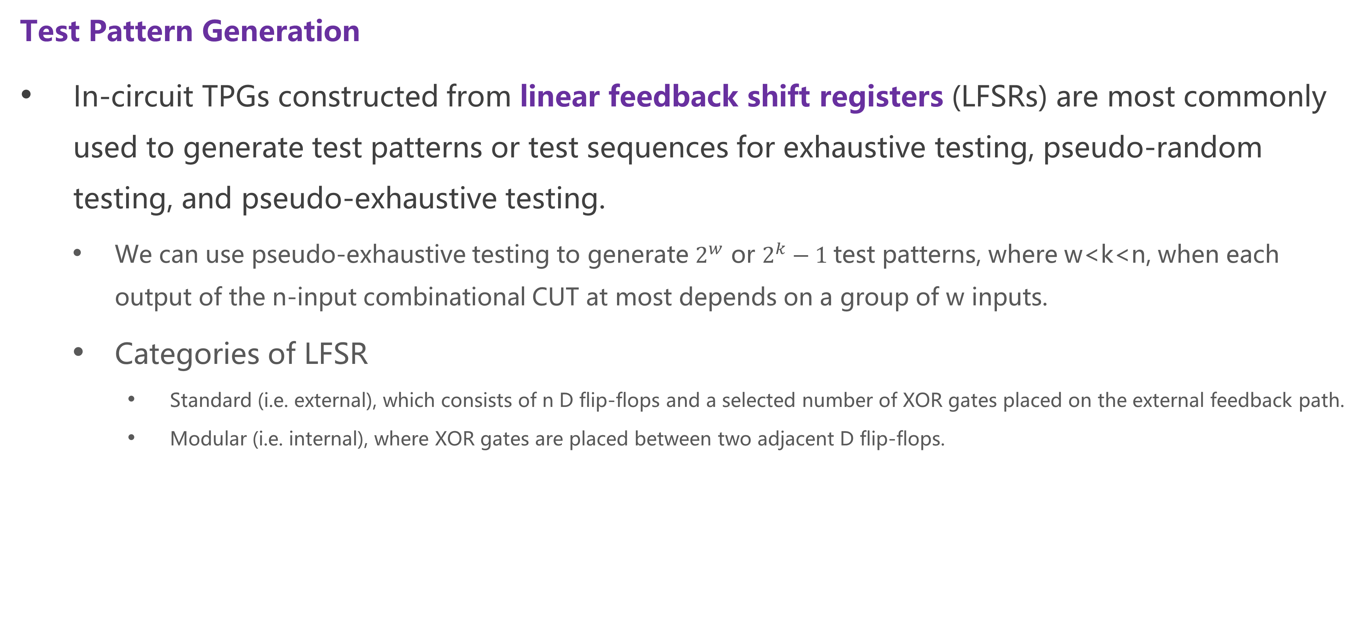
02 Test Pattern Generation
Test Pattern Generation
In-circuit TPGs constructed from linear feedback shift registers (LFSRs) are most commonly used to generate test patterns or test sequences for exhaustive testing, pseudo-random testing, and pseudo-exhaustive testing.
We can use pseudo-exhaustive testing to generate $2^{w}$ or $2^{k}−1$test patterns, where w<k<n, when each output of the n-input combinational CUT at most depends on a group of w inputs.
Categories of LFSR
Standard (i.e. external), which consists of n D flip-flops and a selected number of XOR gates placed on the external feedback path.
Modular (i.e. internal), where XOR gates are placed between two adjacent D flip-flops.

Slide 19
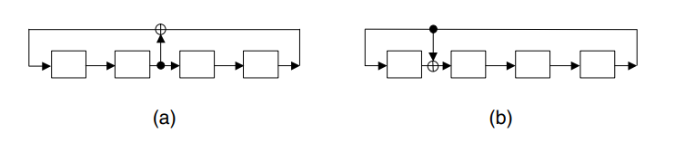
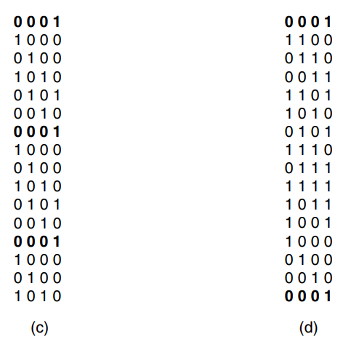
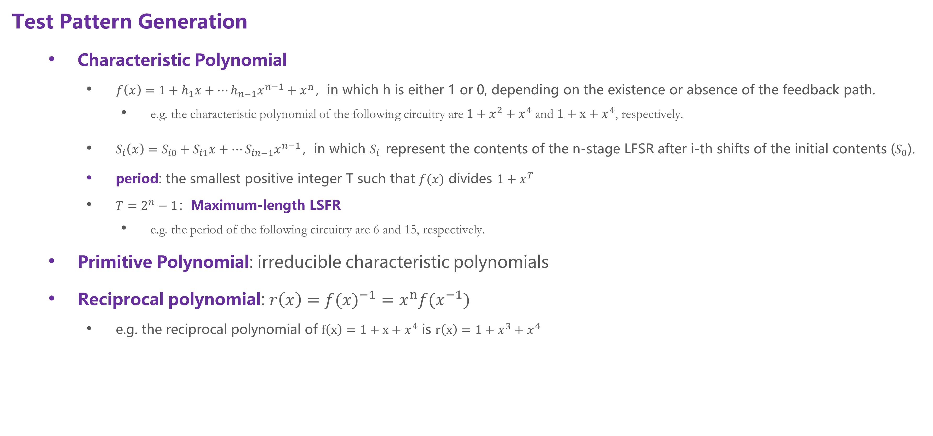
02 Test Pattern Generation
Test Pattern Generation
Characteristic Polynomial
$f\left(x\right)=1+h_{1}x+…h_{n−1}x^{n−1}+x^{n}，$in which h is either 1 or 0, depending on the existence or absence of the feedback path.
e.g. the characteristic polynomial of the following circuitry are${1+x}^{2}+x^{4}$ and $1+x+x^{4}$, respectively.
$S_{i}\left(x\right)=S_{i0}+S_{i1}x+…S_{in−1}x^{n−1}，$in which $S_{i}$ represent the contents of the n-stage LFSR after i-th shifts of the initial contents ($S_{0}$).
period: the smallest positive integer T such that $f(x)$ divides ${1+x}^{T}$
${T=2}^{n}−1：$Maximum-length LSFR
e.g. the period of the following circuitry are 6 and 15, respectively.
Primitive Polynomial: irreducible characteristic polynomials
Reciprocal polynomial: $r\left(x\right)={f(x)}^{−1}=x^{n}{f(x}^{−1})$
e.g. the reciprocal polynomial of $f\left(x\right)=1+x+x^{4}$ is $r\left(x\right)=1+x^{3}+x^{4}$

Slide 20
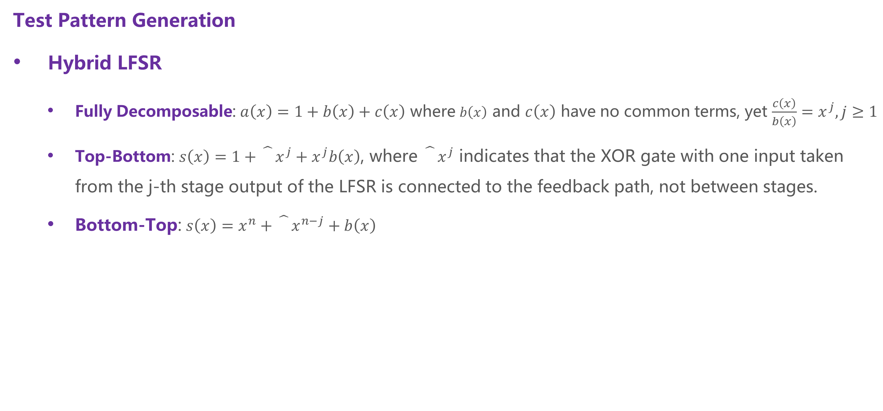
02 Test Pattern Generation
Test Pattern Generation
Hybrid LFSR
Fully Decomposable: $a\left(x\right)=1+b\left(x\right)+c\left(x\right)$ where $b\left(x\right)$ and $c\left(x\right)$ have no common terms, yet $\frac{c\left(x\right)}{b\left(x\right)}=x^{j}, j≥1$
Top-Bottom: $s\left(x\right)=1+\hat{}x^{j}+x^{j}b\left(x\right)$, where $\hat{}x^{j}$ indicates that the XOR gate with one input taken from the j-th stage output of the LFSR is connected to the feedback path, not between stages.
Bottom-Top: $s\left(x\right)=x^{n}+\hat{}x^{n−j}+b\left(x\right)$

Slide 21
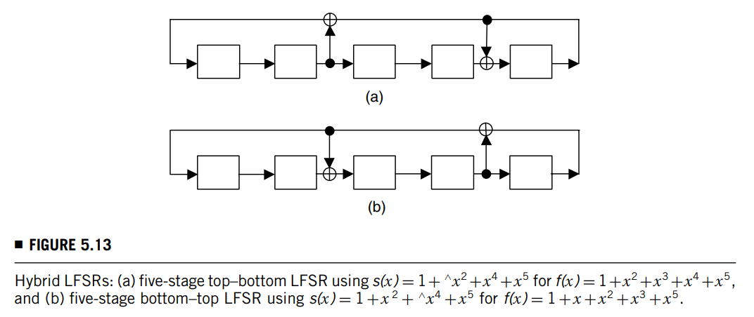

02 Test Pattern Generation
Test Pattern Generation
Hybrid LFSR
Theorem: if a characteristic polynomial $f\left(x\right)$is fully decomposable, then there exists a top-bottom LFSR for it; and if top-bottom LFSRs exist for a characteristic polynomial $f\left(x\right)$, then bottom-top LFSRs will exist for its reciprocal polynomial $r\left(x\right)$.

Slide 22
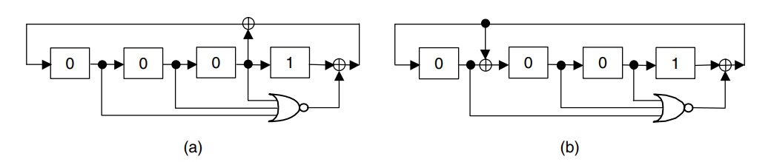
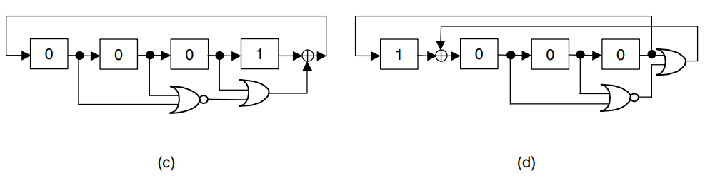
02 Test Pattern Generation – Exhaustive Test
Exhaustive Test
Binary Counter
Maximum-length LSFR (Complete LFSR, CFSR)
For any modular CFSR, the minimization is done by replacing the XOR gate at the last stage by an OR gate and reconnecting the tap to the OR-gate output.
If further minimization is necessary, then using the hybrid LFSR scheme presented above can save about half of the XOR gates required for the feedback connection.
When n is larger than 20, the test time may be prohibitively long and is thus not recommended.

Slide 23
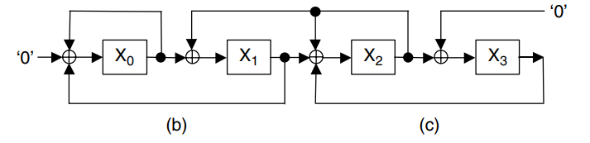
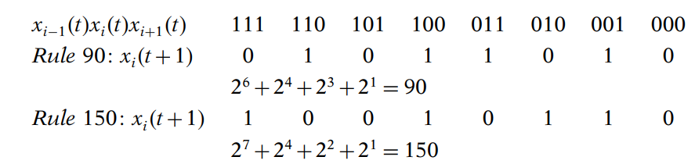
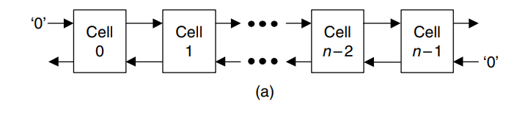
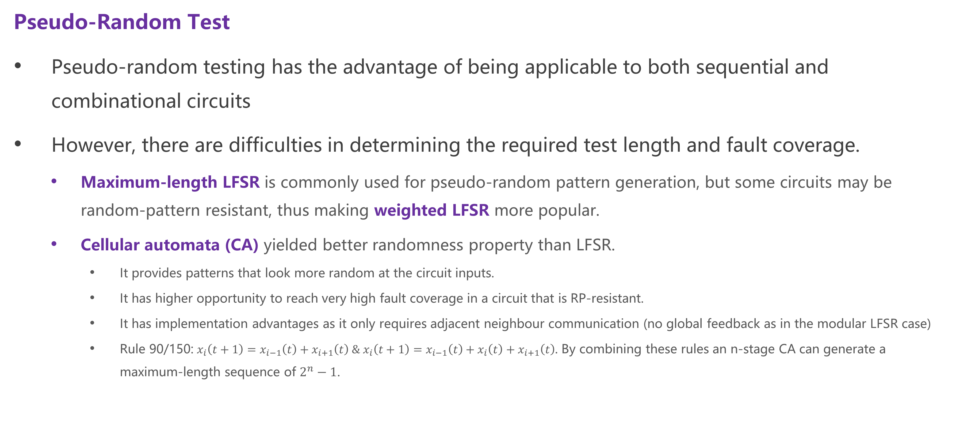
02 Test Pattern Generation – Pseudo-Random Test
Pseudo-Random Test
Pseudo-random testing has the advantage of being applicable to both sequential and combinational circuits
However, there are difficulties in determining the required test length and fault coverage.
Maximum-length LFSR is commonly used for pseudo-random pattern generation, but some circuits may be random-pattern resistant, thus making weighted LFSR more popular.
Cellular automata (CA) yielded better randomness property than LFSR.
It provides patterns that look more random at the circuit inputs.
It has higher opportunity to reach very high fault coverage in a circuit that is RP-resistant.
It has implementation advantages as it only requires adjacent neighbour communication (no global feedback as in the modular LFSR case)
Rule 90/150: $x_{i}\left(t+1\right)=x_{i−1}\left(t\right)+x_{i+1}\left(t\right) \& x_{i}\left(t+1\right)=x_{i−1}\left(t\right)+x_{i}\left(t\right)+x_{i+1}\left(t\right)$. By combining these rules an n-stage CA can generate a maximum-length sequence of $2^{n}−1$.

Slide 24
02 Test Pattern Generation – Pseudo-Exhaustive Test
Pseudo-Exhaustive Test: Verification Testing
(Let w be the maximum number of input variables upon which any output of the CUT depends.)
Syndrome Driver Counter: If n − p inputs, p<n, can share the test signals with the other p inputs, then the circuit can be tested exhaustively with these p inputs.
Constant-Weight Counter: They are constructed using constant-weight code or M-out-of-N code, which contains a set of N-bit codewords, each having exactly M 1’s.
Combined LFSR/SR: a combination of an LFSR and a shift register (SR) is used for pattern generation. The method is most effective when w is much less than n. (e.g., w<n/2) Designs based on this method are simple but require more test pattern.
Combined LFSR/PS: a combination of an LFSR and a linear phase shifter (PS) is used for pattern generation. This method uses at most two seeds; however, the implementation cost is still high.

Slide 25
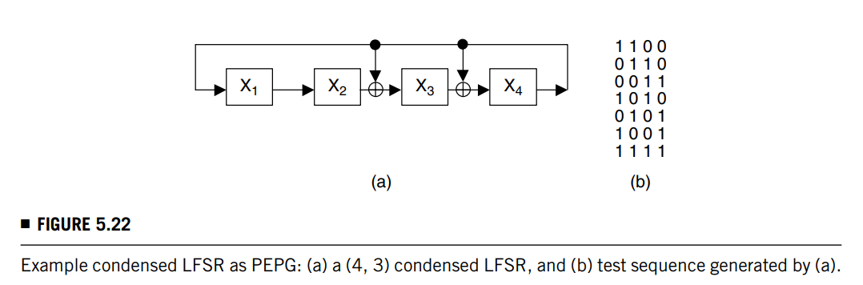

02 Test Pattern Generation – Pseudo-Exhaustive Test
Pseudo-Exhaustive Test: Verification Testing
Condensed LFSR:
Compute the smallest integer k such that: w ≤ $\left\lceil \text{k}\text{/}\text{(}\text{n}\text{−}\text{k}\text{+1}\text{)}\right\rceil +\left\lfloor \text{k}\text{/}\text{(}\text{n}\text{−}\text{k}\text{+1}\text{)}\right\rfloor .$For such k we have: $p\left(x\right)=\frac{f(x)}{1+x+…x^{n−k}},$ and an (n, k) condensed LFSR is such realized.
For any given (n, w) CUT, this method uses at most two seeds and has shown to be effective when w ≥ n/2.
Designs based on this method are simple; however, this technique uses more patterns than the LFSR/SR approach when w < n/2.
Use cyclic LFSR based on cyclic code for reducing the test length when w < n/2.

Slide 26
02 Test Pattern Generation – Pseudo-Exhaustive Test
Pseudo-Exhaustive Test: Segmentation Testing
Partitions may divide the signal paths through the circuit rather than only separating the signal paths from each other.
Hardware partitioning: based on inserting multiplexers and connecting the embedded inputs and outputs of the subcircuit to those primary inputs and outputs that are not used by the subcircuit under test.
Sensitized partitioning: achieved by applying the appropriate input patterns to some of the input lines.
Partitioning VLSI circuits is an NP-complete problem. Thus, sensitized partitioning, which does not alter the functional circuitry, is the preferred technique.

Slide 27
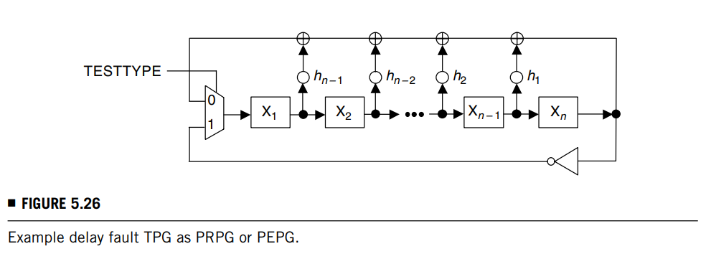
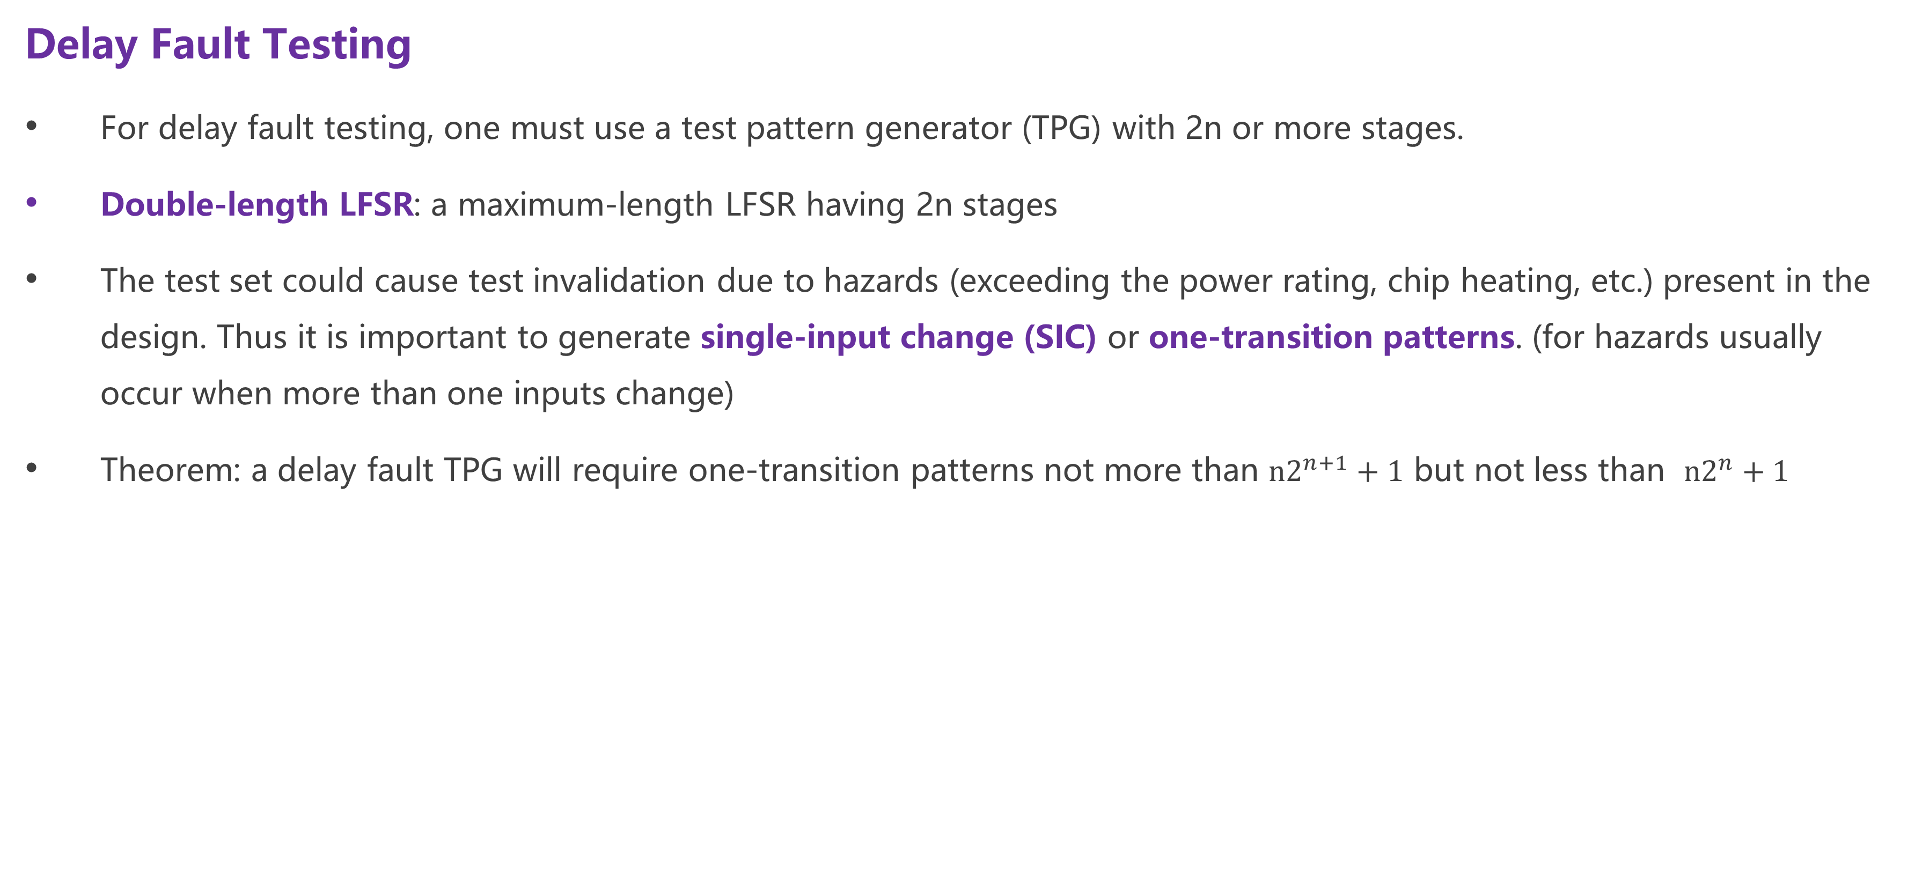
02 Test Pattern Generation – Delay Fault Testing
Delay Fault Testing
For delay fault testing, one must use a test pattern generator (TPG) with 2n or more stages.
Double-length LFSR: a maximum-length LFSR having 2n stages
The test set could cause test invalidation due to hazards (exceeding the power rating, chip heating, etc.) present in the design. Thus it is important to generate single-input change (SIC) or one-transition patterns. (for hazards usually occur when more than one inputs change)
Theorem: a delay fault TPG will require one-transition patterns not more than ${n2}^{n+1}+1$ but not less than ${n2}^{n}+1$

Slide 28
OUTPUT RESPONSE ANALYSIS
03

Slide 29
03 Output Response Analysis
Output Response Analysis
Compaction differs from compression in that compression is loss-less, while compaction is lossy.
Compaction: a method for dramatically reducing the number of bits in the original circuit response during testing in which some information is lost.
Compression: a method for reducing the number of bits in the original circuit response in which no information is lost, such that the original output sequence can be fully regenerated from the compressed sequence.
For output response analysis throughout the remainder of the book we will refer to the lossy compression as “compaction.”
When using compaction, it is important to ensure that the faulty and fault-free signatures are different. It is also important to ensure that none of the output responses contain an unknown (X) value.

Slide 30
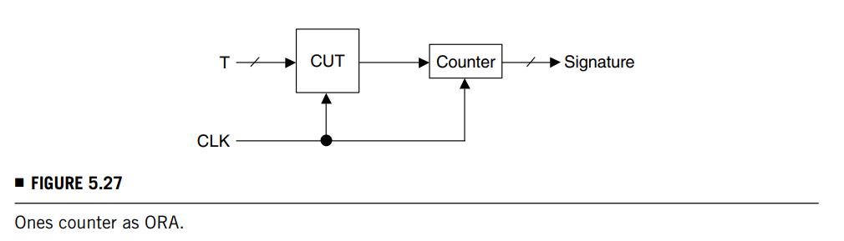
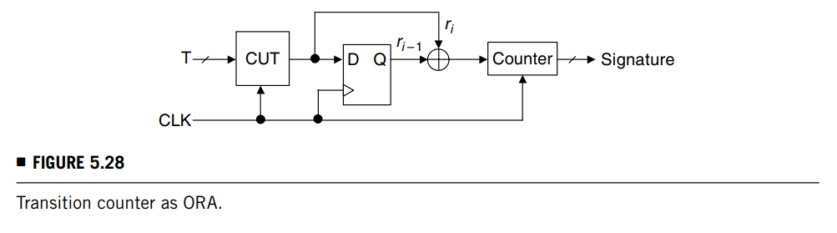

03 Output Response Analysis – Count Testing
Ones Count Testing
The ones count test technique will only require a counter to count the number of 1’s in the bit stream.
Masking probability (possibility of a L-bit output to result in m): $P_{OC}\left(m\right)=(C\left(L,m\right)−1)/(2^{L}−1)$
Transition Count Testing
The transition count test technique will only require a counter to count the number of 0-to-1 and 1-to-0 transitions.
Masking probability: $P_{TC}\left(m\right)=(2C\left(L−1,m\right)−1)/(2^{L}−1)$

Slide 31
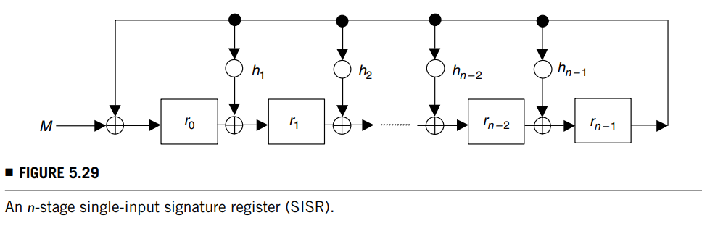

03 Output Response Analysis – Signature Analysis
Signature Analysis
Serial Signature Analysis
Output sequence: $M\left(x\right)=m_{0}+m_{1}x+…m_{L−1}x^{L−1}$ (seen below)
After shifting the L-bit output sequence M into the modular LFSR, the remainder of the SISR: $r\left(x\right)=r_{0}+r_{1}x+…r_{n−1}x^{n−1}$
Let the characteristic polynomial of the modular LFSR be f(x). Thus we must have M(x)=q(x)f(x)+r(x). Check r(x) for fault detection.
Aliasing probability: $P_{SSA}\left(n\right)=(2^{L−n}−1)/(2^{L}−1)$. (there are $2^{L−n}$ possible ways among $2^{L}$ways of producing an n-bit signature of which one is the correct signature). If L >> n then $P_{SSA}\left(n\right)$ is approximately $2^{−n}.$

Slide 32


03 Output Response Analysis – Signature Analysis
Signature Analysis
Serial Signature Analysis
$f(x) = 1+x+x^{4}$
M = {10011011}, $m\left(x\right)= 1+x^{3}+x^{4}+x^{6}+x^{7}$ (count 1 from left to right)
$q\left(x\right)= x^{2}+x^{3},r(x) = {1+x}^{2}+x^{3}$ (polynomial division, m(x)/f(x))
R = {1011} (fault-free signature)
M’ = {11001011} with fault f1, $m′\left(x\right)= 1+x+x^{4}+x^{6}+x^{7}$
$q\left(x\right)= x^{2}+x^{3},r\left(x\right)=1+x+x^{3}$
R’ = {1110} (fault signature, detected)
M’’ = {11001101} with fault f2, $m′′\left(x\right)= 1+x+x^{4}+x^{5}+x^{7}$
$q\left(x\right)=x+x^{3},r\left(x\right)= {1+x}^{2}+x^{3}$
R’’ = {1011} (same with fault-free signature, fault not detected)

Slide 33
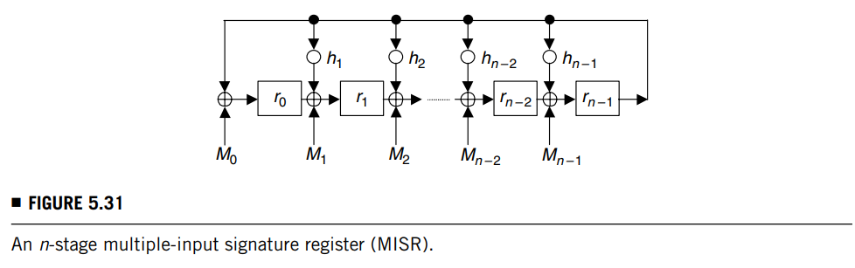

03 Output Response Analysis – Signature Analysis
Signature Analysis
Parallel Signature Analysis
Effective input sequence: $M\left(x\right)=M_{0}\left(x\right)+{xM}_{1}(x)+…x^{n−1}$ $M_{n−1}\left(x\right)$
Effective error polynomial: $E\left(x\right)=E_{0}\left(x\right)+{xE}_{1}(x)+…x^{n−1}$ $E_{n−1}\left(x\right)$
Aliasing probability: $P_{PSA}\left(n\right)=(2^{mL−n}−1)/(2^{mL}−1)$. (there are $2^{mL−n}$ possible ways among $2^{mL}$ways of producing an n-bit signature of which one is the correct signature). If L >> n then $P_{PSA}\left(n\right)$ is approximately $2^{−n}.$
Example:
Let $M_{0}$ = {10010}, $M_{1}$ = {01010}, $M_{2}$ = {11000}, and $M_{3}$ = {10011}
Using $M\left(x\right)=M_{0}\left(x\right)+{xM}_{1}(x)+…x^{n−1}$ $M_{n−1}\left(x\right)$ (n=4) to obtain $M\left(x\right)=1+x^{3}+x^{4}+x^{6}+x^{7}$ (i.e. M = {10011011})
Therefore, R = {1011} (fault-free signature)

Slide 34
LOGIC BIST ARCHITECTURE
04

Slide 35
04 Logic BIST Architecture
Logic BIST Architecture
Categories:
those that assume no special structure to the circuit under test
those that make use of scan chains in the circuit under test,
those that configure the scan chains for test pattern generation and output response analysis
those that use the concurrent checking (implicit test) circuitry of the design.

Slide 36
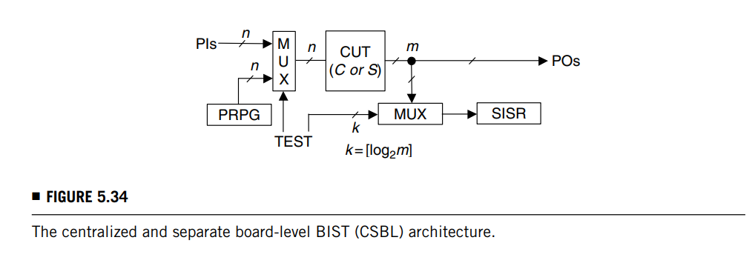
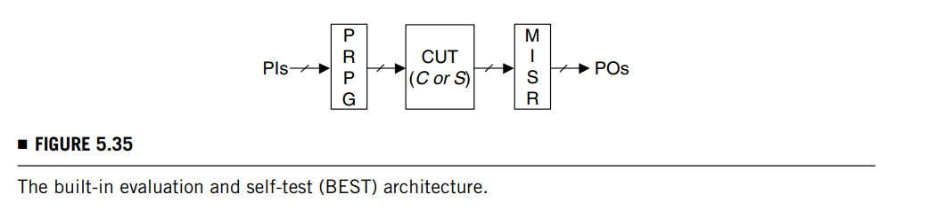
04 Logic BIST Architecture - BIST Architectures for Circuits without Scan Chains
BIST Architectures for Circuits without Scan Chains
centralized and separate board-level BIST architecture (CSBL): two LFSRs and two multiplexers are added to the circuit.
The first multiplexer selects either the primary inputs or the PRPG outputs to drive the circuit under test.
The second multiplexer routes the primary outputs (POs) of the circuit to the SISR.
Additional circuitry is used to compare the final signature of the SISR with an embedded known good signature. It also provides a pass/fail indication once the test is complete.
built-In evaluation and self-test(BEST)

Slide 37
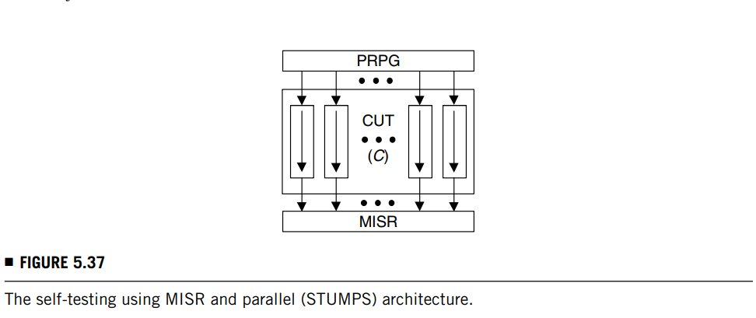
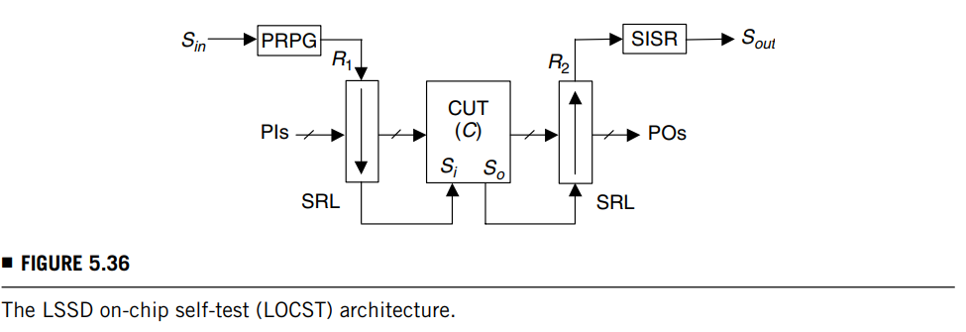
04 Logic BIST Architecture - BIST Architectures for Circuits with Scan Chains
BIST Architectures for Circuits with Scan Chains
LSSD on-chip self-test (LOCST): an external scan chain comprised of all primary inputs and primary outputs of the CUT is required.
The external scan chain input is connected to the internal scan chain output.
Pseudo-random patterns are generated by a PRPG and are shifted into the combined scan chain.
The system clocks are triggered and the contents of the scan chain latches are shifted out to a SISR.
The final signature is then compared in the SISR with a precomputed fault-free signature in order to generate a pass/fail error signal.
The scan output is also connected to a pin so, in case of a failure, intermediate signatures can be examined externally for diagnosis purposes.
self-testing using MISR and parallel SRSG (STUMPS)

Slide 38
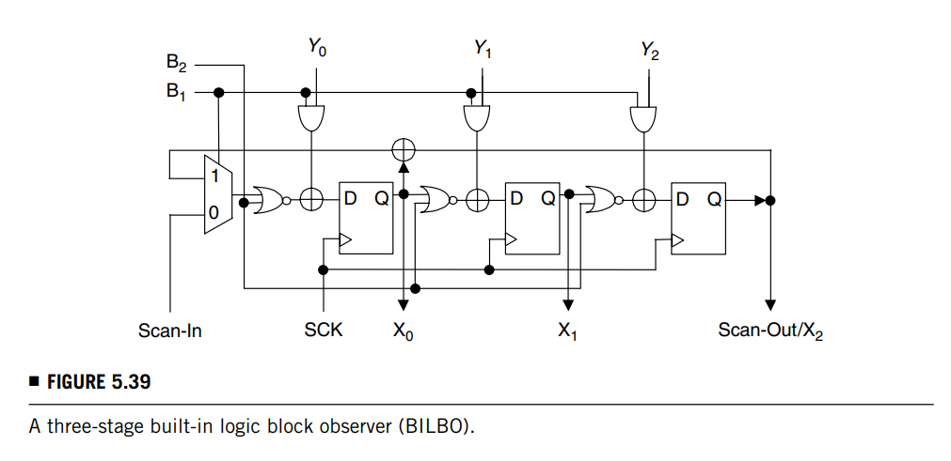
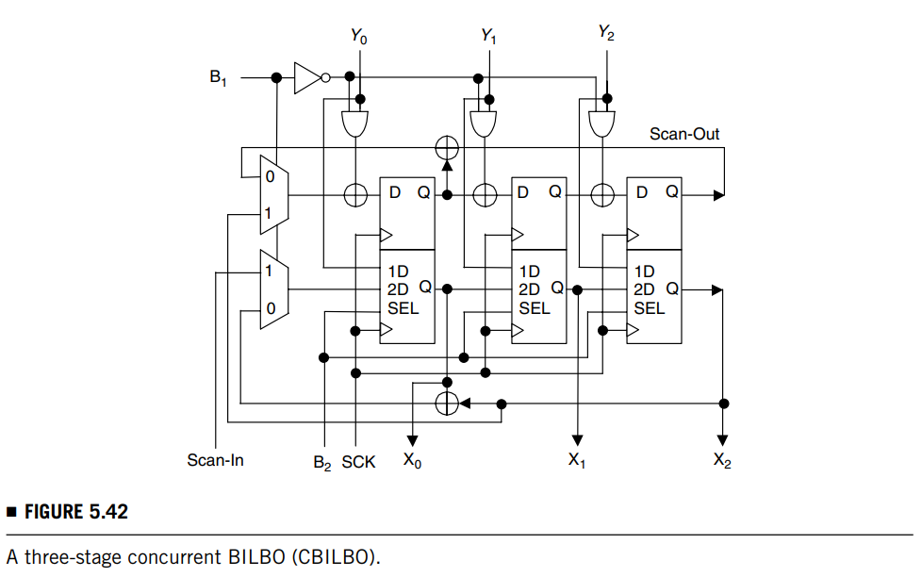
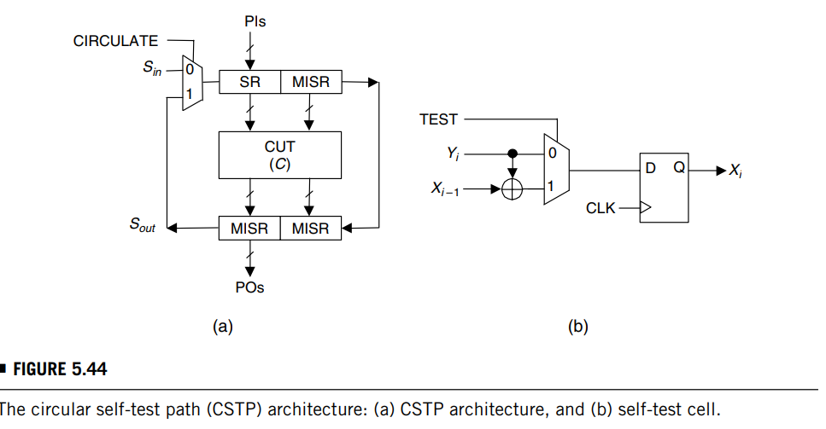
04 Logic BIST Architecture - BIST Architectures Using Register Reconfiguration
BIST Architectures for Circuits with Scan Chains
built-in logic block observer (BILBO):
It is controlled by two control inputs B1 and B2, and it works in the following four modes.
Normal mode: when both control inputs B1 and B2 are equal to 1, the circuit functions in normal mode with the inputs gated directly into the D flip-flops.
Scan mode: when both control inputs are equal to 0, the BILBO is configured as a shift register. Test data can be shifted in or out.
Test generation / Signature analysis mode: setting B1 = 1 and B2 = 0 converts the BILBO into a MISR. It can then be used in this configuration as a TPG.
Reset mode: the BILBO is reset after a system clock is triggered when B1 = 0 and B2 = 1.
modified BILBO & concurrent BILBO, circular self-test path (CSTP) (all primary inputs and primary outputs are reconfigured as external scan cells)

Slide 39
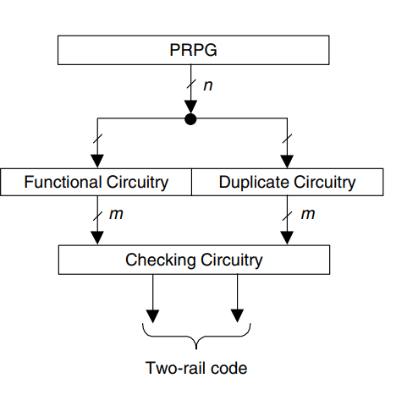
04 Logic BIST Architecture - BIST Architectures Using Register Reconfiguration
BIST Architectures Using Concurrent Checking Circuits
A PRPG is applied to the CUT and the duplicate circuitry.
The duplicate circuitry is realized in complementary form to reduce design and common-mode faults.
This technique avoids the aliasing problem and consequent loss of effective fault coverage.

Slide 40
FAULT COVERAGE ENHANCEMENT
05

Slide 41
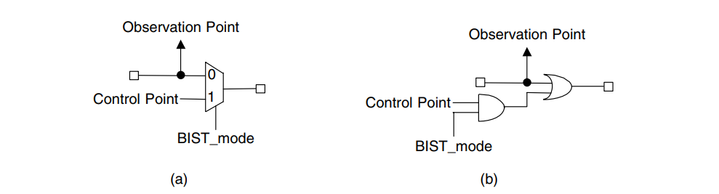
05 Fault Coverage Enhancement – Test Point Insertion
Fault Coverage Enhancement - Test Point Insertion
A control point can be connected to a primary input, an existing scan cell output, or a dedicated scan cell output.
During normal operation, all control points must be deactivated.
During testing, there are different strategies as to when and how the control points are activated. (random / deterministic activation)
An observation point can be connected to a primary output through an additional multiplexer, an existing scan cell input, or a dedicated scan cell input.
Because test points add area and performance overhead, an important issue for test point insertion is where to place the test points in the circuit to maximize the coverage and minimize the number of test points required.
Fault simulation guided techniques: given this set of patterns, fault simulation is used to identify which faults will not be detected during self-test. Test points are then inserted to enable those faults to be detected.
Testability measure guided techniques avoid the problems of knowing any knowledge of the TPG.
Gradient technique, Tamarapalli technique, …

Slide 42
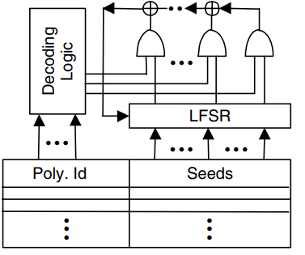
05 Fault Coverage Enhancement – Mixed Mode BIST
Fault Coverage Enhancement – Mixed Mode BIST
ROM compression: store patterns in ROM, but the size of ROM is often required to be prohibitively large.
LFSR seeding: requiring less ROM storage since seedings are smaller than patterns.
Embedding deterministic patterns: some of those “useless” patterns can be transformed into deterministic patterns that detect RP-resistant faults.

Slide 43
05 Fault Coverage Enhancement – Hybrid BIST
Fault Coverage Enhancement – Hybrid BIST
Deterministic data from the tester can be used to improve the fault coverage.
The simplest approach is to obtain a set of deterministic test patterns that “top-up” the fault coverage to the desired level and then store those patterns directly on the tester.

Slide 44
BIST TIMING CONTROL
06

Slide 45
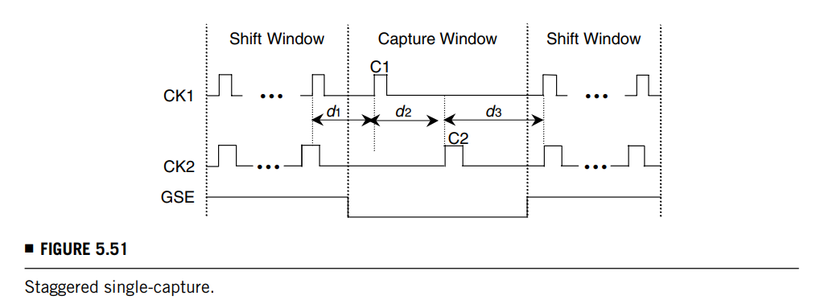
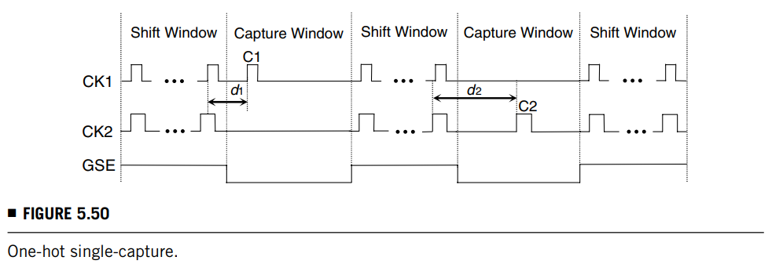
06 BIST Timing Control – Single Capture
BIST Timing Control – Single Capture
One-hot: a capture pulse is applied to only one clock domain during each capture window, while all other test clocks are held inactive. This scheme can only test intra-clock-domain and inter-clock-domain structural faults.
easy to integrate with scan.
longer test time
Staggered: capture pulses C1 and C2 are applied in a sequential or staggered order during the capture window to test all intra-clock-domain and inter-clock-domain structural faults in the two clock domains.
shorter test time
possible structural fault coverage loss

Slide 46
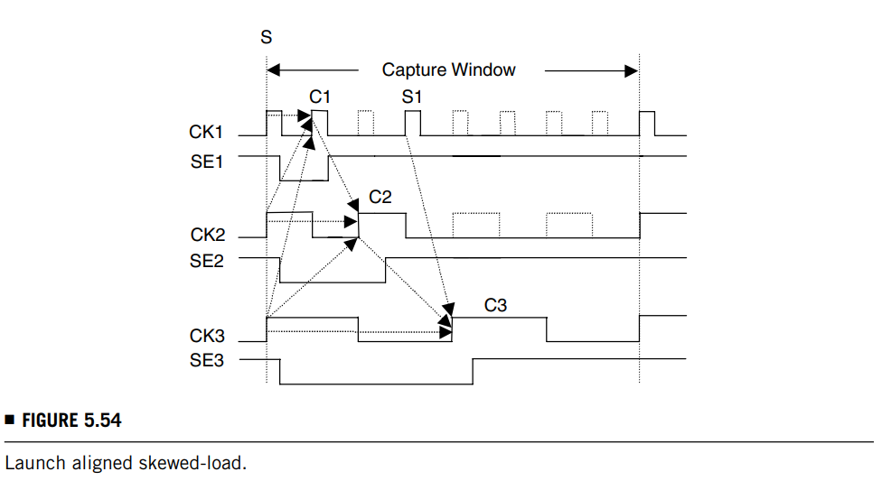
06 BIST Timing Control – Skewed Load
BIST Timing Control – Skewed Load (a last shift pulse followed immediately by a capture pulse, running at the test clock’s operating frequency, to launch the transition and capture the output response)
One-hot:
cannot be used to detect inter-clock-domain delay faults
has a long test time
is incompatible with scan,
Staggered:
is extremely difficult in physical implementation
all other clock frequencies must be derived from the reference clock
Aligned: (aligning all capture edges together)
all intra-clock-domain and inter-clock domain faults can be tested

Slide 47
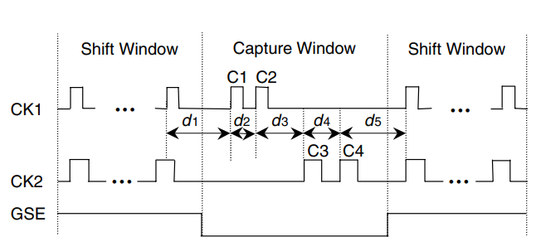
06 BIST Timing Control – Double Capture
BIST Timing Control – Double Capture (two consecutive capture pulses are applied to launch the transition and capture the output response) (also referred to as “broad-side” or “launch-on” capture)
One-hot:
cannot be used to detect inter-clock-domain delay faults
has a long test time
Aligned: (aligning all capture edges together)
solves the drawbacks of one-hot double capture
still requires the precise alignment of the capture pulses (making the physical implementation difficult)
Staggered:
significantly eases physical implementation
allows us to integrate logic BIST with scan/ATPG easily in order to improve the circuit’s manufacturing fault coverage.

Slide 48
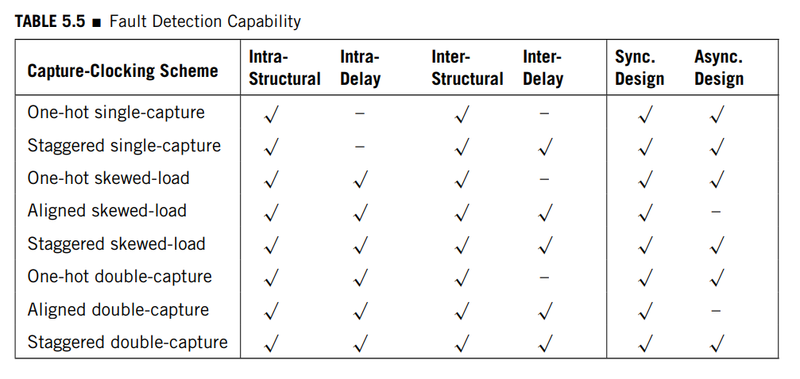
06 BIST Timing Control – Fault Detection
BIST Timing Control – Fault Detection

Slide 49
Thanks for listening!
Haochen Ding

